Slide 1


BANKING PRESENTATION

Slide 2

ABOUT US
SkyBits Technologies, Is an Artificial Intelligence software development firm providing solutions and products to various global clients. It was founded by the veterans of the IT industry with immense global experience. The core focus areas for SkyBits are Image Processing and Natural Language Processing (NLP) based on strong foundations in Deep Learning technologies.

Slide 3
Management Team and Founders
Debabrata Dutta, Founder and Executive Director
Industry Experience: 30 Years
Past Organizations: DRDO, Wipro, Lucent, Ushacomm
Expertise: Machine Learning, Telecom, Parallel Computing,, Mobility
Education: M Tech Computer Sc. IISc Bangalore; B Tech Computer Sc. IIT Kharagpur
Satyajit Roy - Head of International Business Development
Industry Experience: 4 Years
Past Organizations: DNV-GL(Kuwait), Go Marine, Early Stage Start-ups
Expertise: Technology Evaluation, Data analytics, management systems, Business Development, Six Sigma Black Belt
Education: Electrical Engineering & Economics from Pennsylvania State University (USA)
Ambar Mukerji, Executive Director
Industry Experience: 32 Years
Past Organizations: Lovelock/Flakt/Digital (DEC), Xerox(USA), Telstra, CFO UshaComm and early stage companies as CFO/COO/CEO.
Expertise: Financial and Business Management and Business Development and Financing
Education: Chartered Accountant and St Xaviers Kolkata

Slide 4
Tirthankar Banerjee – Advisor
Industry Experience: 30 Years
Past Orgs: Digital, Compaq, Sun, HCL Tech, HP
Expertise: Business Management, Machine Learning
Education: PGDM Marketing IMT; B Tech E&ECE IIT Kharagpur
Capt. Soumitro Roy - Advisor
Sujan Sinha – Advisor
Industry Experience: 40 Years
Past Orgs: Mobil, SCI, Reliance Industries, KOTC, ADNOC
Expertise: Commercial and operational Management of ships, Ani Piracy, Maritime training, Maritime software, management Consultancy
Education: St Xavier's Kolkata, Master Mariner
Industry Experience: 37+ years
Past Organisations: SBI, Usha Martin Finance, Axis Bank, Shriram Housing Finance
Expertise: Retail Banking, Consumer Lending, Mortgages
Education: Presidency College, Kolkata
Nirendu Konar – Advisor
Industry Experience: 30 Years
Past Orgs: CISCO, SAIL, Wipro, Mastech, IBS
Expertise: Machine Learning, Deep learning, Business Analytics
Education: M Tech IIT Kharagpur, MBA University of Phoenix

Slide 5




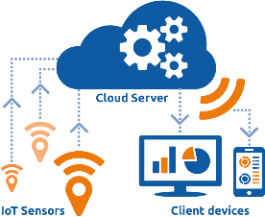


Solution & Technologies
Deep Learning
Statistical Analysis
Mobile Computing
and eLearning
Natural Language
Processing
Image Processing

Slide 6






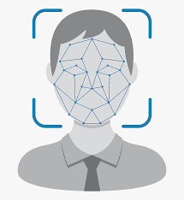



Implemented Solutions
.
Prediction Modelling
CV Classification
E-KYC
Email and Document Classifier
Vehicle Recognition
Social feed Classifier
Chat Bot
Multi-Lingual Chat
Face Recognition
Drones

Slide 7






Solution Framework
Vehicle Recognition
Deployment
And Interfaces
Data Sources
Face Recognition
Data
On Premises
Cloud
Web API
Structured Data
Unstructured Rich data
Unstructured Data
Chatbots
Audio
classifier
Drone, store
Video analytics
Text Classifier
&
Summarization

Slide 8













Technology Stack
MOBILE TECHNOLOGY
NEAR REAL TIME ANALYTICS
MACHINE LEARNING
Generic/ Cloud

Slide 9

Our Products
SkyChat
Automated Chat system for the banking, HR and Hospitals
Handle basic queries as well as advanced features like online payment, scheduling etc
Can answer in different languages as well as voice based
Face-O-Detect
Automated image analysis system
Ideally used for taking attendance
Other uses include detecting PPE, Eye ball tracking, trespassers warning and tracking etc
It works online as well as offline and can be used on tablet mobile & phone or through CCTV camera feed

Slide 10


Our Products
Appraisal Review System
Developed for the shipping industry
KPI’s of the firm are being matched with a specific rank
People are getting a number based appraisal that is unbiased compared to the age old method of managers giving ratings
Training module also included in the system
Ideal for any corporate entity
Automated Credit Analyzer
Developed for the banking industry as an aid to loan approving
NLP based system that analyzed the company audit reports, particularly the Directors report
All information is highlighted as a positive negative or neutral comment
Based on the analysis, an annual report is being analyzed within a few minutes.

Slide 11
Our Products
DigiDoc
OCR solution that can extract information from a form or document and digitize the same.
Currently digitizes information from scan or pictures of Aadhar card, pan card and any passports
Ideal solution for auditing firm or any B2C industry that deal with forms and application
SkyGist
NLP based system that can analyze a large number of text
Used for social media feed classification
Information is classified and sentiments are analyzed

Slide 12





BANKING – HNI & PRIVILEGED CUSTOMERS
USE CASE 1 - ATM Usage for HNI Customers
In addition to PIN,
System scans face
HNI Customer
walks into ATM
Inserts Privilege
card to ATM
Customer & Bank
alerted in case of
mismatch
Authorized Customer

Slide 13



BANKING – PRIVILEGED CUSTOMERS
USE CASE 2 – Automated Identification of Privileged Customers in Bank
HNI Customer
Approaches Bank
Once entering Bank, Face
is scanned to check for
privilege Customers
Once match identified,
notification sent to
Branch representative
Bank Representative
immediately approaches
Customer for services

Slide 14


BANKING CHATBOT
Customers
Ticket raised and estimated time to resolve matter sent to customer
Answer
Generic/personalized questions
Any Type of non-official Queries
SkyBits Complaint classification and management software
Intent Classification Algorithm

Slide 15









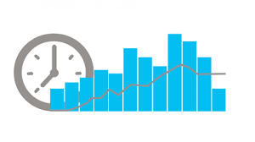








CYBER SECURITY
Orchestration, Analysis, Reporting & Visualization
Ticketing System
Incident Management
Search & Analysis
Malware Management
Reporting
Assessment Tools
SIEM
Analytics Engine
Other Services
WASA & VA PT
Threat intelligence
IdAM
Real Time Analytics
DATA STORAGE
Compliance
Threat Hunting
PIM & PAM
Historical Analytics
Security Audits
Device Management
Malware and Web

Slide 16








AUTOMATED CHEQUE ISSUING
Owner
Creator
Software
Verifier
Soft copy of check
Final Authorizer
Copy sent to bank
Beneficiary

Slide 17








E-KYC Solution
Bank Customer
True/False
Documentations
Extracted Data
Bank ERP
E-KYC
True/False
National DataBase

Slide 18


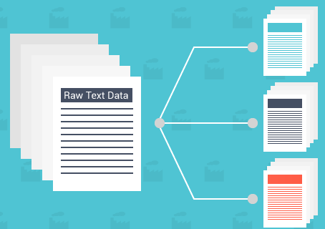


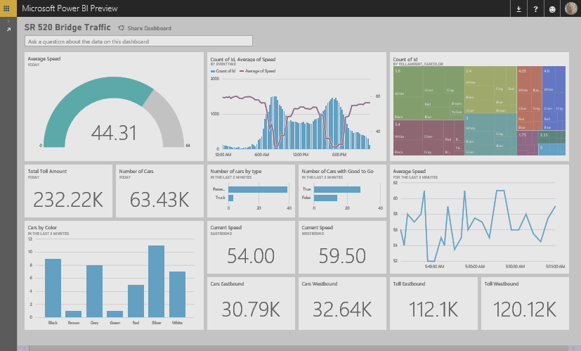

Automatic Handling of Customer Feedbacks
System Waits for new email and sends to the Classifier
Machine Learning
Based Classifier
Categorise reviews
based on feedback
Customer sends email to Customer Care
Take Appropriate Action
Based on Business Logic
Live Dashboard using streaming data

Slide 19

















Using Machine Learning in Digitization of Forms
1
Scan new documents
Documents from Current system
Upload Image
2
Key-Value
Extraction
Supporting
Documents
Image
enhancement
Extraction of
printed data
Extractions of
key – value pairs
Extracted
Data
Extract to tables
Audits
3
Location
Compliance
Data Validations
Other
validations
Photo
Verify
Validation OK
At Field or Branch
Extract to tables

Slide 20
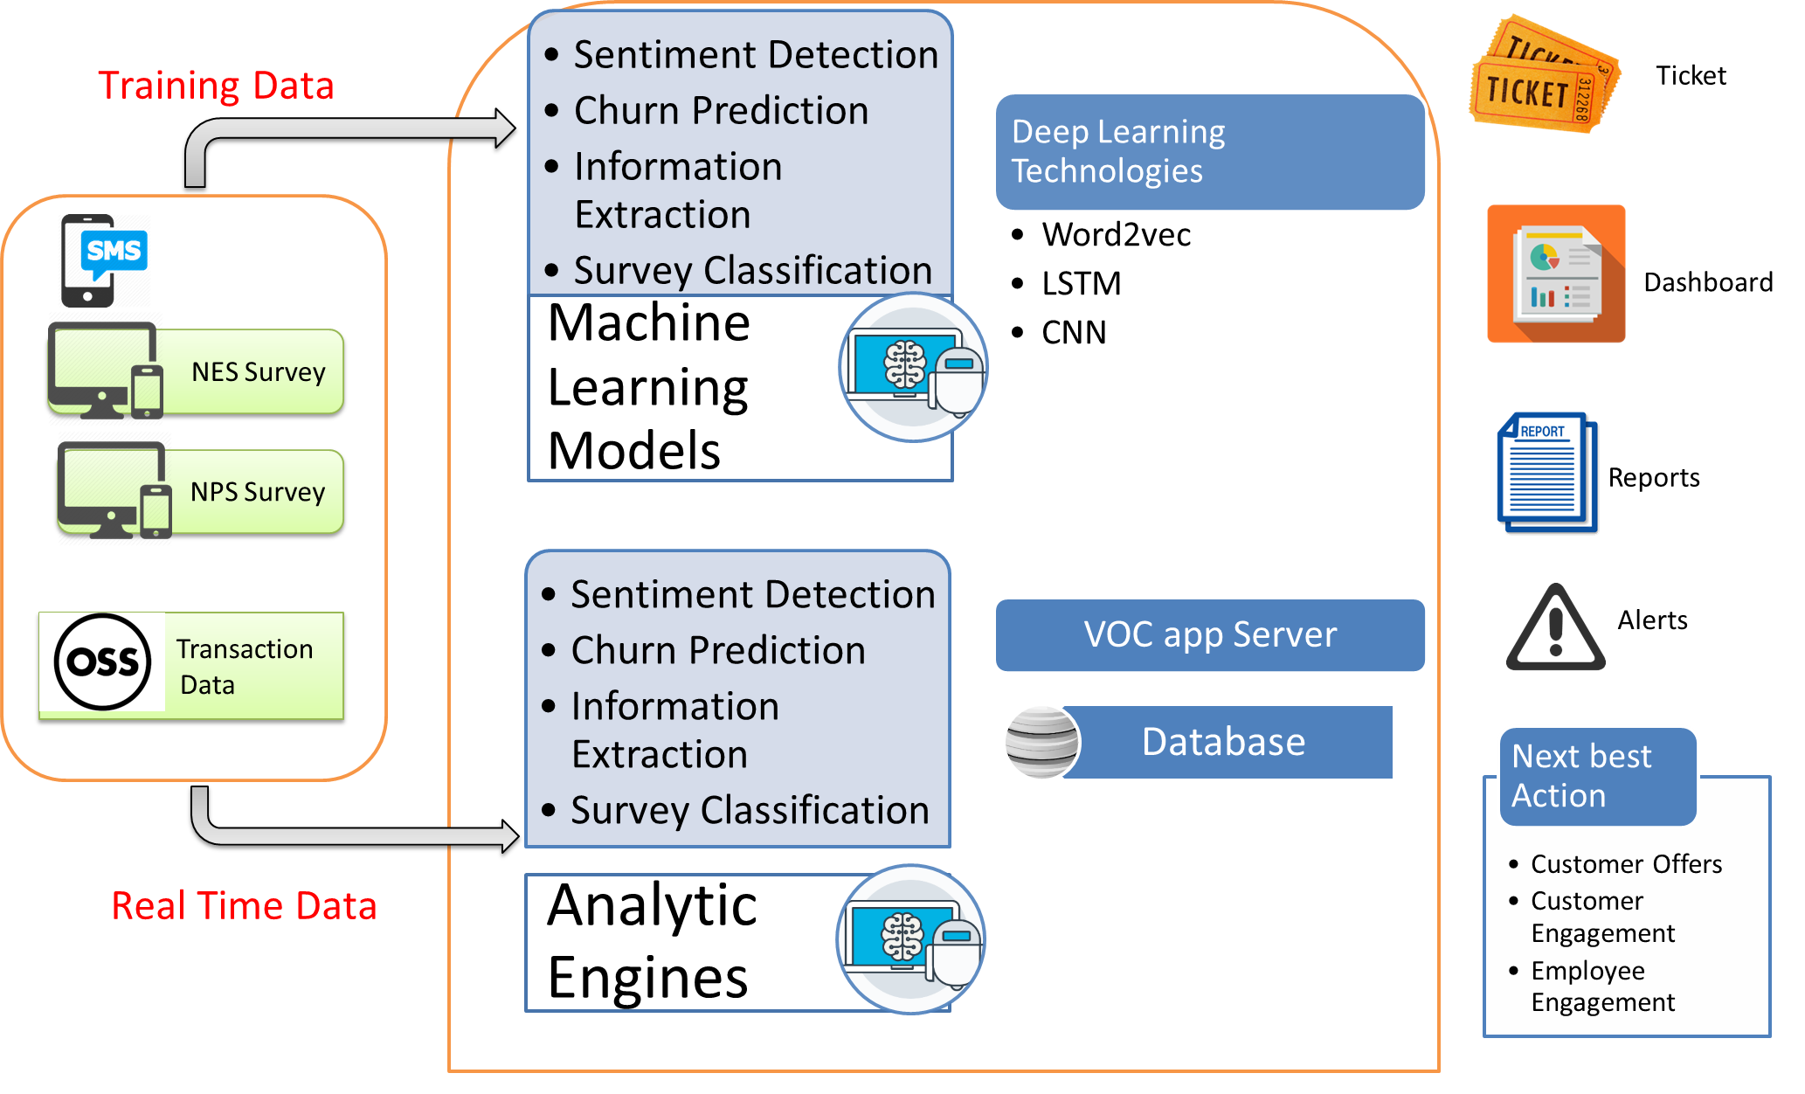
VOICE OF CUSTOMER

Slide 21




HR - RECRUITMENTS
USE CASE 3 – Automated Mapping of JD with CVs and Faster closing of open positions
ML Algorithms reads JD &
scans list of CVs & web crawls through partner sites for matching CVs
Shortlisted CVs are ranked
Using Linear regression &
Latent semantic analysis
Only the top ranked
shortlisted individuals
are interviewed
HR receives Job
description from
respective department

Slide 22



ADMIN – DOCUMENT & EMAIL MANAGEMENT
Email Classification & routing to appropriate group based on content
Automatic document Cataloging, legacy data digitization and categorization for easier search.
Document Matching Solutions, by extracting information from documents. Coupled with Facial recognition, can be used in E-KYC verification

Slide 23


SOCIAL FEED CLASSIFIER
& RECOMMENDATIONS
Product Review Summarization based on feedbacks from social media / forums
Product recommendations based on past usage, patterns and statistical analysis
Automatic Customer Feedback Handling from company sites / social media; Routing

Slide 24
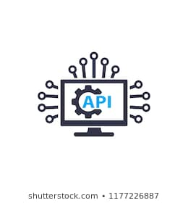






Video Attendance
OPTION 1: CAMERA BASED
Employee Enters
the office and
stands near a designated camera
Yellow: Analyzing face
Green: Face Recognized
Data sent to Skybits
System

Slide 25




Video Attendance
OPTION 2: PERSONAL MOBILE APP
Client Wifi Network
Face-O-Detect
mobile App
Video or Selfie
taken
Data sent to cloud
API integration with
Client HRM software

Slide 26






OUR CLIENTS

Slide 27
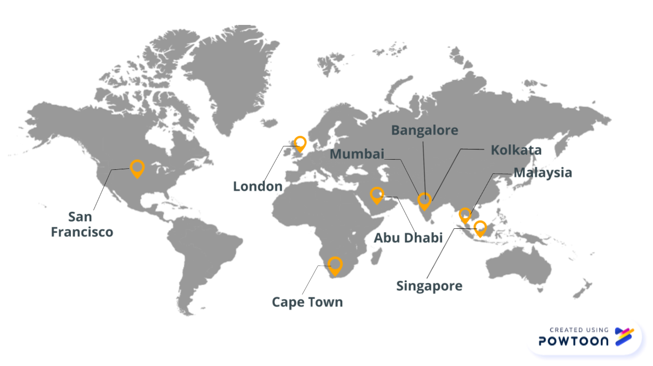
OUR GLOBAL PRESENCE

Slide 28
CONTACT US
+91-33-4000-3881
info@sky-bits.com
1416 DLF Galleria, Action Area 1B, New Town, Kolkata 700156, India
Visit us : http://sky-bits.com/

